Slide 1


Combating human trafficking in the hospitality sector – update
Dr Kate Clayton-Hathway
kclayton-hathway@brookes.ac.uk
Oxford Brookes Business School (Centre for Diversity Policy Research and Practice)
EUROCHRIE Webinar
4th June 2020

Slide 2

Agenda
What are human trafficking and modern slavery?
Why is the hotel/hospitality sector at risk?
The COMBAT THB (trafficking human beings) project and toolkit
COVID-19: issues and responses

Slide 3
What are human trafficking and modern slavery?
“The recruitment, transportation, transfer, harbouring or reception of persons, including the exchange or transfer of control over those persons, by means of the threat or use of force or other forms of coercion, of abduction, of fraud, of deception, of the abuse of power or of a position of vulnerability or of the giving or receiving of payments or benefits to achieve the consent of a person having control over another person, for the purpose of exploitation”.

Slide 4
What are human trafficking and modern slavery?
Exploitation includes:
• sexual exploitation
• forced labour, including forced criminality
• slavery or practices similar to slavery
• servitude
• removal of organs
• forced begging
• illegal adoption
• forced marriage
The consent of a victim is irrelevant when means of exploitation can be found. In particular, when trafficking involves a child

Slide 5
Facts and figures
Estimated 40.3 million people in modern slavery, including 24.9 million in forced labour.
5.4 victims of modern slavery for every 1,000 people in the world.
16m exploited in the private sector such as domestic work, construction or agriculture; 4.8m persons in forced sexual exploitation, and 4m persons in forced labour imposed by state authorities.
Women and girls are disproportionately affected by forced labour, accounting for 99% of victims in the commercial sex industry, and 58% in other sectors
1 in 4 victims of modern slavery are children.
(ILO, 2020, Forced labour, modern slavery and human trafficking, https://www.ilo.org/global/topics/forced-labour/lang--en/index.htm)

Slide 6
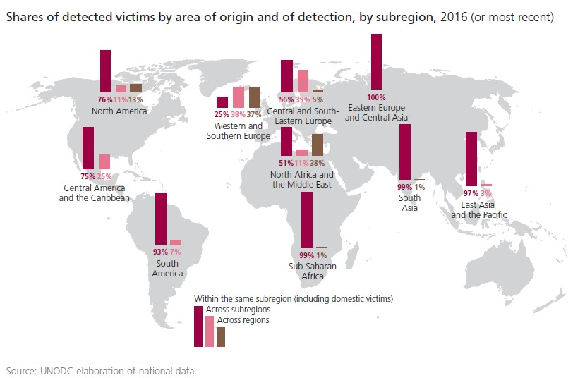
Changes and trends in trafficking and modern slavery

Slide 7
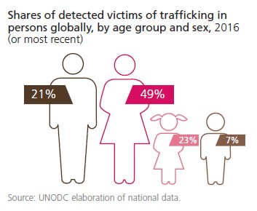
Changes and trends in trafficking and modern slavery
Globally, countries are detecting and reporting more victims
More trafficking of domestic victims
Richest countries are destinations for long-distance flows
Mainly women and girls are targeted
Trafficking for sexual exploitation the most detected form (not across all regions)
Can be driven by armed conflicts

Slide 8
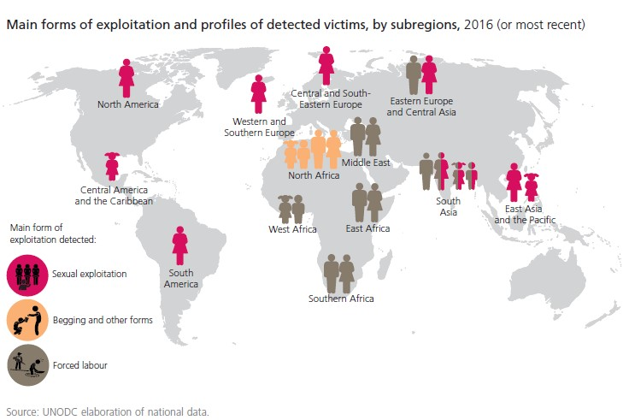
Changes and trends in trafficking and modern slavery

Slide 9
Human trafficking training for management level stakeholders
Why is the hotel industry vulnerable to THB?
Strategic
Organisational Culture
Technological
Operational
Employment Practices
Outsourcing Strategies

Slide 10
What is the case for action?
Reputational
Enhance staff morale and operational efficiency
Opportunity to build brand and corporate identity
Legal requirements for disclosure, etc
Investor groups’ increasing interest
Moral obligation

Slide 11

COMBAT HUMAN TRAFFICKING EU Project – core goals and aims
Comprehensive training kit
Support structures to actively engage all levels
Robust models
Sustain organisational environment
Better support victims

Slide 12
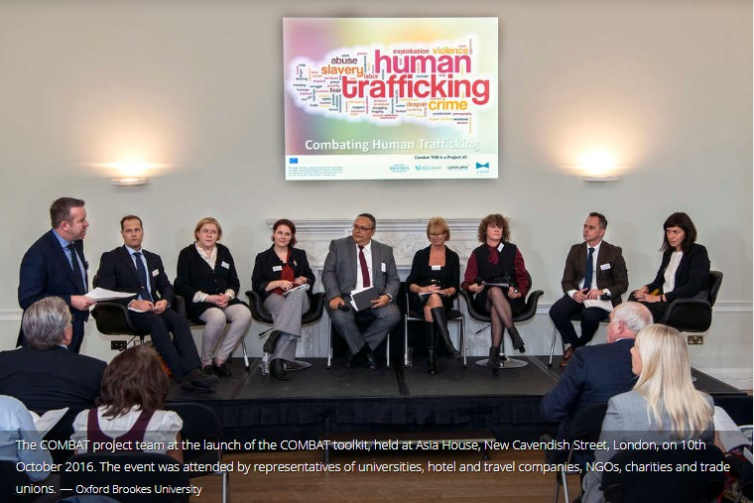
COMBAT HUMAN TRAFFICKING EU Project

Slide 13
COMBAT THB – the toolkit
Reference guides for hotel staff, senior managers and boards (with accompanying slides)
A trainer’s manual
7 case studies
A set of ‘10-minute trainers’
‘Aide memoires’
Example posters

Slide 14
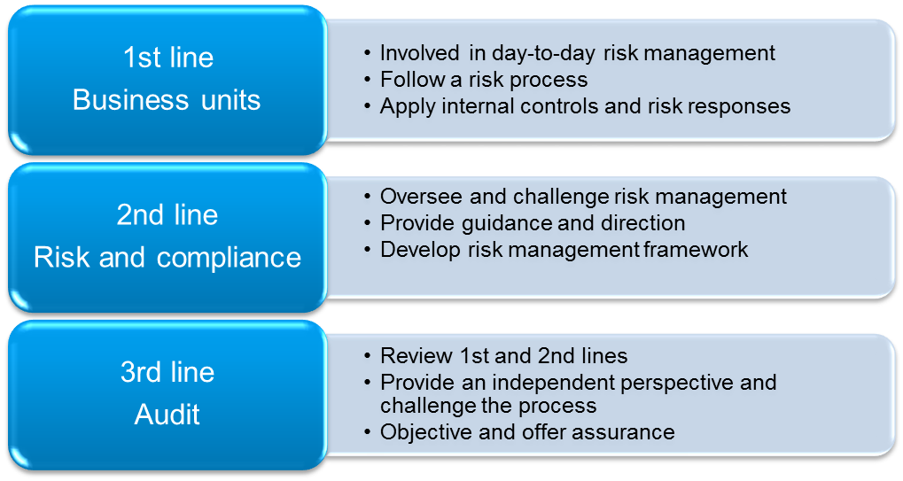
Human trafficking training for management level stakeholders
Three lines of defence

Slide 15
Why it is important to communicate about THB?
An enhanced level of awareness of front- and back-of-the-house THB risks amongst all employees
Sensitivity to these risks across the organisation with effective monitoring and reporting of possible signals (red flags)
The ability of operational management to invoke the relevant procedures, when appropriate

Slide 16
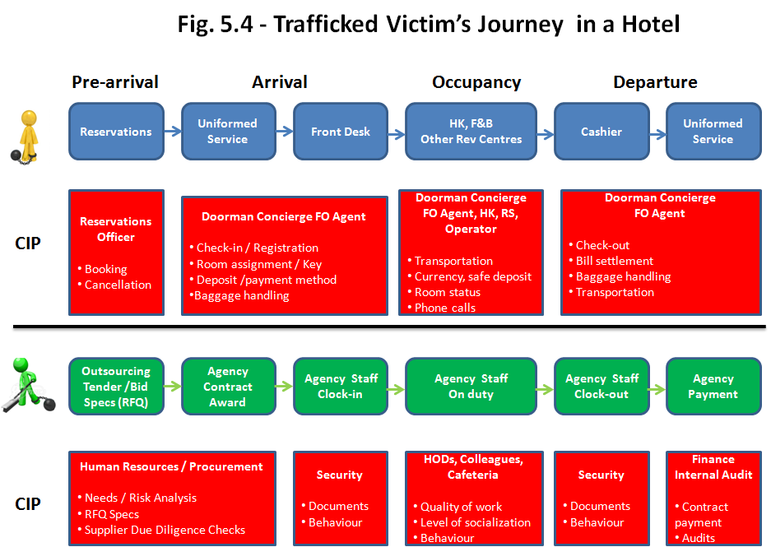
Human trafficking training for management level stakeholders
A useful step to identify possible vulnerabilities is to look at where THB interfaces with the hotel front- and back-of-the house and the possible journeys of trafficked victims within a hotel.

Slide 17
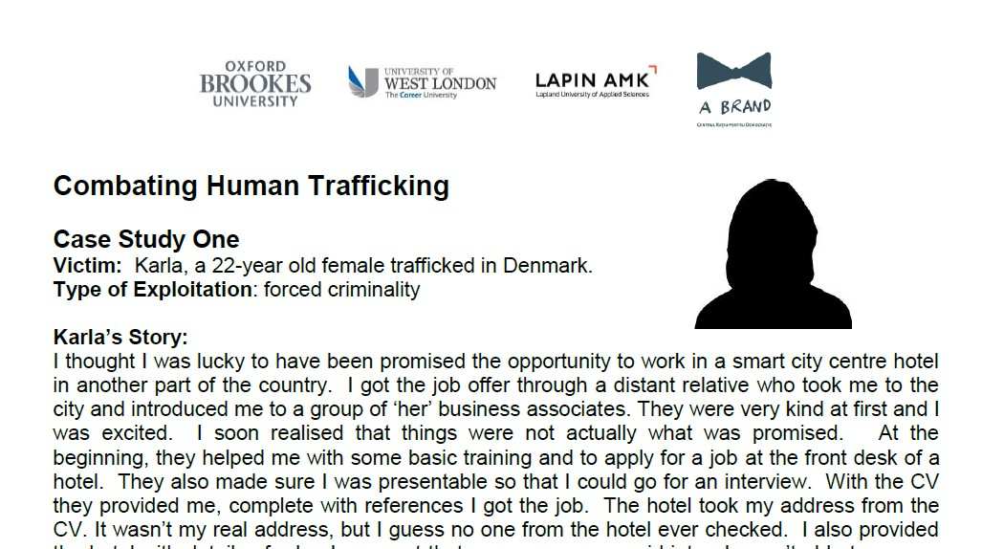
The toolkit – 7 case studies

Slide 18
Case of Luka
Luka’s Story:
I was 19 when first heard of the opportunity to come to the UK to work in the agricultural sector. I already had lots of experience of working on my family’s farm in Lithuania. I had been brought up from a very early age to help out in looking after the livestock on the farm; mainly cattle and sheep. I thought that working abroad would enable me to send some money back to me parents, they were struggling to make ends meet on the farm, and I could save up to have my own farm one day.
I spoke to a friend of mine who said that an agency in Vilnius could secure me a job in return for paying them a percentage fee out of my wages. I applied and was told to turn up in the capital city in two days’ time to be provided with a work visa and plane ticket. What an adventure! I was astonished, therefore, to find myself joining 30 other men one cold morning in October on a rickety bus that would take us eventually to the North of England. It was a long journey, but we finally arrived at a very large egg farm. This is where things went downhill! This farm in Northumberland was not the only place where all 30 of us worked. We were driven literally around the whole of the UK, changing location sometimes after a few days, sometimes after a few weeks. We worked back-to-back eight-hour shifts for days and days at a time.
(continued…)

Slide 19
Case of Luka
Working as egg catchers, the conditions were often dangerous. I thought I would be working alongside nice farming folk like my parents but instead we were assaulted and abused by the Lithuanian supervisors.
These were not nice people; they often didn’t let us sleep or take toilet breaks and repeatedly withheld payment from us. I say ‘payment’ but really we got a pittance and were often told that if we didn’t continue to work our families would suffer back home. They kept our passports and said that the majority of our wages were going back to the agency to pay for our passage over to the UK and the opportunity of work. Some opportunity, it was torture! They even used fighting dogs to intimidate us and to get us to stay in the horrible farm outbuildings when not working where the mattresses on the floor were riddled with bedbugs. We were sometimes given nothing to eat so we had to pilfer eggs and were forced to eat them raw.
Just think how surprised I was when one day I found out that the company we worked for supplied the free-range eggs, at a low cost, we were collecting to fast-food chains and major supermarket chains.

Slide 20
How to act with victim if you face him/her?
Advice and guidance to help to develop appropriate organisational policies
Staff training and updates on anti-trafficking legislation, prevention and awareness campaigns
Support and guidance when a trafficking incident occurs
Emotional and psychological support for victims, which can make a tremendous difference
Interpreters to help victims overcome language barriers
Access to food and clothing for victims
Advice for victims on rebuilding their lives; e.g. on immigration laws, accommodation, personal finance, access to healthcare, language lessons and employment
See and contact: NGO’s in operation!

Slide 21

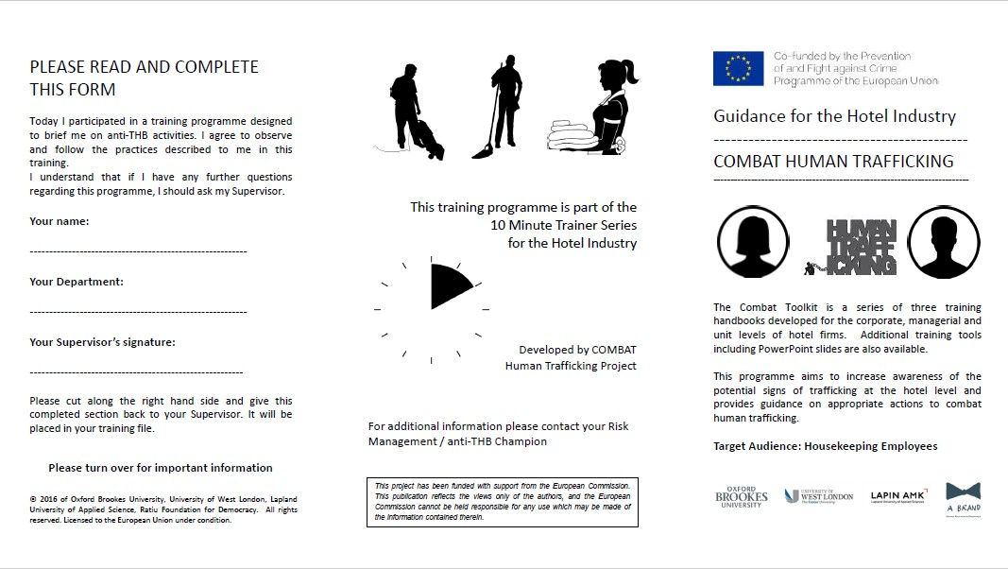
The toolkit – trainer manual and ‘10-minute trainers’ and ‘aide memoires’

Slide 22
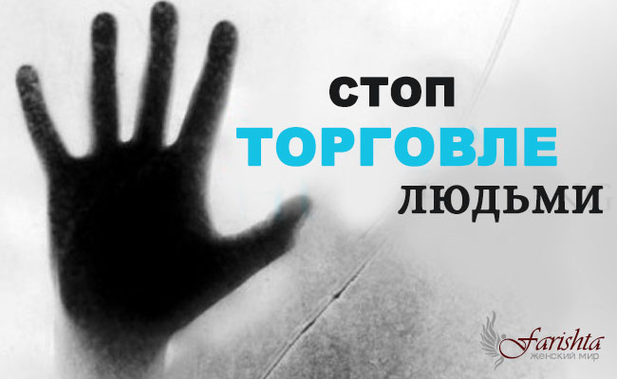


The toolkit – example posters

Slide 23
COMBAT THB – impact and follow-on work
Toolkit officially endorsed by the Institute of Hospitality
Toolkits disseminated with international, European and national organisations
Delivered at police modern slavery conferences
Workshops for Hotel Watch initiatives
Awards and workshops at industry conferences
Professional panel members for anti-trafficking initiatives
Finnish team working with government agencies, NGOs and industry professionals
Romanian team presented to ILO and the National Agency against Human Trafficking
Results embedded into academic curricula
Industry/educational associations hosting/providing links to toolkit
Press articles

Slide 24
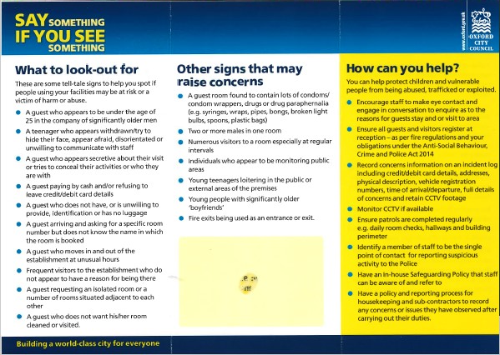
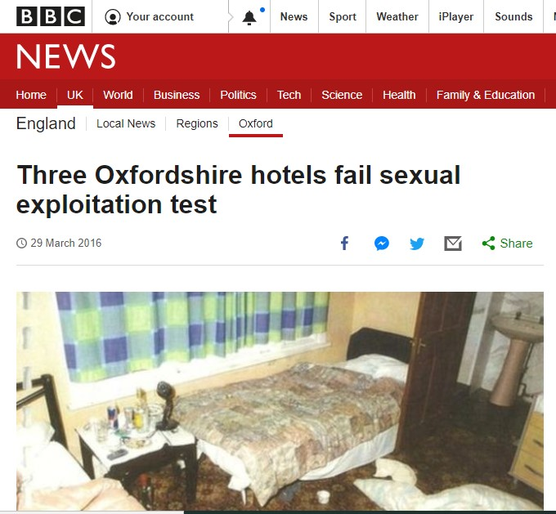
Impact and follow-on: Oxford City Hotel Watch

Slide 25
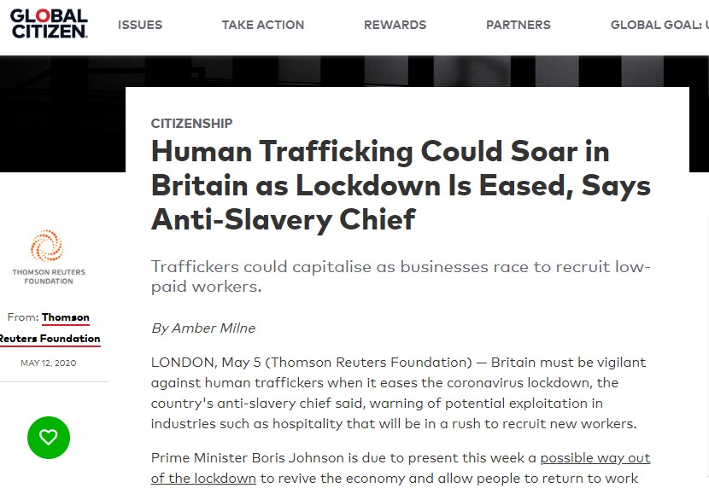
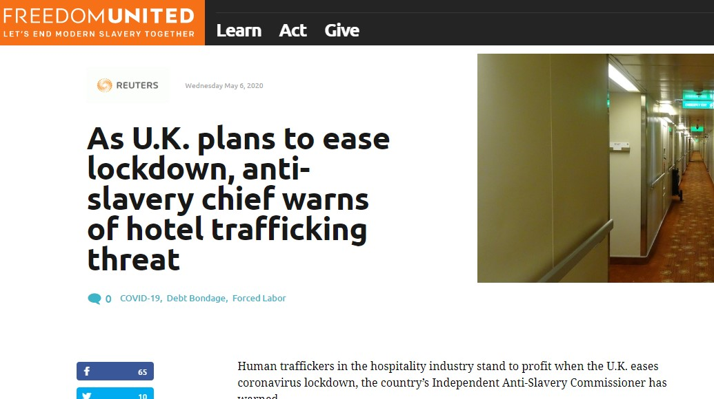
COVID-19 – what next?

Slide 26
COVID-19 – hospitality responses
Positive response to the crisis
Going forward: increased use of technology (for cleaning, meal delivery, contactless check-in/check-out/room keys)
Social distancing of guests
Minimising guest interactions with hotel staff
Need to remain vigilant

Slide 27
Useful links, resources and references
References
A. Paraskevas and M. Brookes, Human trafficking in hotels: an invisible threat for a vulnerable industry (2018), International J. of Contemporary Hospitality Management, 30: 3, 1996-2014.
UNODC, Global Report on Trafficking in Persons 2018, https://www.unodc.org/documents/data-and-analysis/glotip/2018/GLOTiP_2018_BOOK_web_small.pdf
COMBAT THB
Website https://www.brookes.ac.uk/microsites/combat-human-trafficking/
COMBAT THB downloadable materials: https://www.brookes.ac.uk/microsites/combat-human-trafficking/the-toolkit/toolkit-material/?langtype=2057
Hotels and trafficking
https://www.greenhotelier.org/know-how-guides/addressing-human-trafficking-in-the-hospitality-industry/
https://hospitalityinsights.ehl.edu/human-trafficking-hospitality-industry
https://www.hospitalitynet.org/news/4098377.html
https://www.hospitalitynet.org/opinion/4094248.html
https://hospitalityinsights.ehl.edu/human-trafficking-hotel-industry

Slide 28
Useful links, resources and references
Anti-trafficking organisations
https://www.stopthetraffik.org/
https://www.antislavery.org/
https://www.humantraffickingfoundation.org/
https://www.freedomunited.org/
COVID-19 responses
http://www.hotelnewsnow.com/Articles/302715/Conveying-hotel-cleanliness-during-COVID-19-crisis?dm_t=0,0,0,0,0
https://www.business-humanrights.org/en/hospitality-sector-taking-range-of-steps-to-support-communities-during-covid-19-outbreak
https://www.business-humanrights.org/en/human-rights-guidance-tools-for-companies-during-covid-19
Note: the blue slides in this presentation are used directly from COMBAT THB toolkit materials

Slide 29

Thanks for taking part – any questions?
@kateclaytonh

